Slide 1

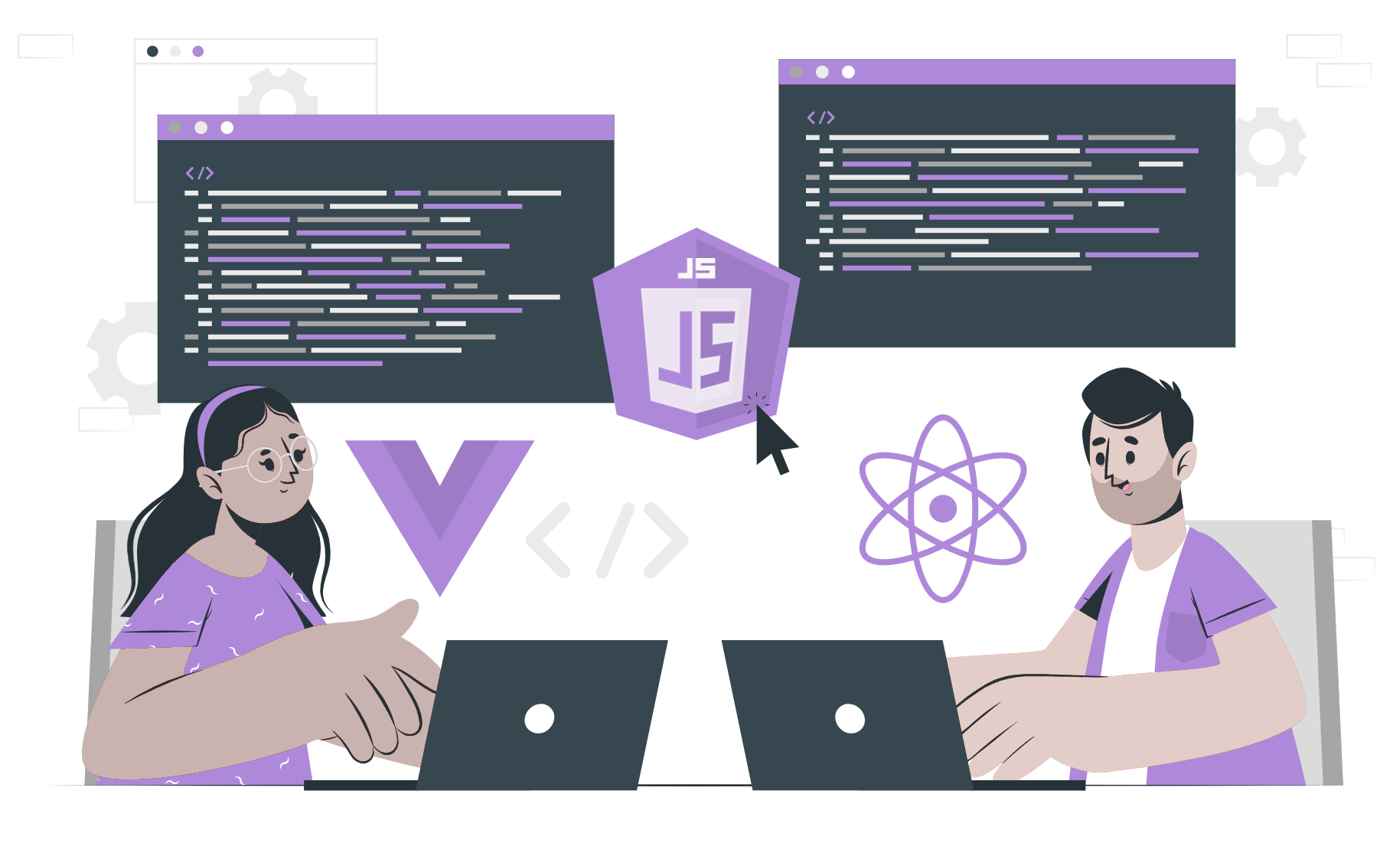
What and Why Express

Slide 2
Topics
Different types of NodeJs Frameworks
What is Express
Why do we use Express

Slide 3
What are Frameworks
A framework is a software tool or platform that provides developers with a set of pre-written code, components, and libraries that they can use to build applications.
Frameworks often include a set of guidelines and best practices that help developers to write code more efficiently and to build applications that are more stable, secure, and scalable.
Some popular web development frameworks include Ruby on Rails, Django, Laravel, React, Angular, and Vue.js.
Frameworks can vary in complexity and size, from lightweight micro-frameworks that provide only the bare essentials, to full-stack frameworks that include everything from front-end libraries to back-end database integration.

Slide 4
What are the different types of Node.js Framework
Some of the different types of Node.js Frameworks that help software architects to develop applications efficiently and with ease are as follows -
Express.js
Koa.js
Nest.js
Hapi.js
Fastify.js
Sails.js

Slide 5
What is Express
Express is an open-source backend web application framework for building Restful APIs with Nodejs.
It is fast, unopinionated, minimalist web framework for Node.js
Express.js was founded by TJ Holowaychuk.
Its main key features are Robust routing and Middleware function.
Express is a back-end component of popular development stacks like MEAN, MERN, or MEVN, together with the MongoDB database software and a Javascript Front-end framework or library.

Slide 6
Continue …
Express can used by installing, importing and creating the instance of using the following command.
Install
`npm install express`
importing
`const express = require(“express”)`
Create an instance of Express
`const app = express()`

Slide 7
Why do we use Express.js
Lightweight and unopinionated Nodejs framework
Fast and Efficient for building scalable web applications with high traffic
Large and active community as a result there are plenty of resource available for learning and troubleshooting.
Easy to learn due to its simplicity and intuitive API that is easy to learn even for new developers who are new to Nodejs
Modular and Extensible
Routing and middleware support which provides a powerful routing system and middleware support, making it easy to handle complex requests and responses.

Slide 8
THANK YOU

